Slide 1
International Trade Conflicts, Past and Present
Alan V. Deardorff
For presentation to
Federal Reserve Bank Chicago
Detroit Board Director Luncheon
April 16, 2018

Slide 2
Outline
  Smoot-Hawley Tariffs, 1930s
  US-Japan trade frictions, 1980s
  Trade disputes under WTO
  Trade policy under Trump

Slide 3
Smoot-Hawley Tariffs
1920s: US already had high tariffs
  1922: Fordney-McCumber Act raised tariffs to average 40%
  Prompted retaliation by European governments
  Prosperity continued until 1929
  1928: Hoover promised higher tariffs but was blocked in the Senate

Slide 4
Smoot-Hawley Tariffs
1930: Tariff Act raised tariffs
  Smoot and Hawley authored Tariff Act of 1930
  Raised tariffs
    Average rose by about 20%
    Levied on many goods (900-20,000)
  More than 1,000 economists signed letter opposing it
  President Hoover signed it June 17, 1930
  Many countries retaliated with higher tariffs

Slide 5
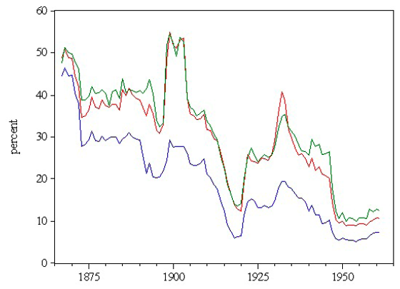
US tariff history: 1865-1960
Fordney-McCumber
Smoot-Hawley
Average tariff
Today
Today
Notes:
Source: Irwin, Doug, “Trade Restrictiveness and Deadweight Losses from U.S. Tariffs,” 22 December 2008, Figure 1.

Slide 6
Smoot-Hawley Tariffs
1930’s
  World trade shrank dramatically

Slide 7
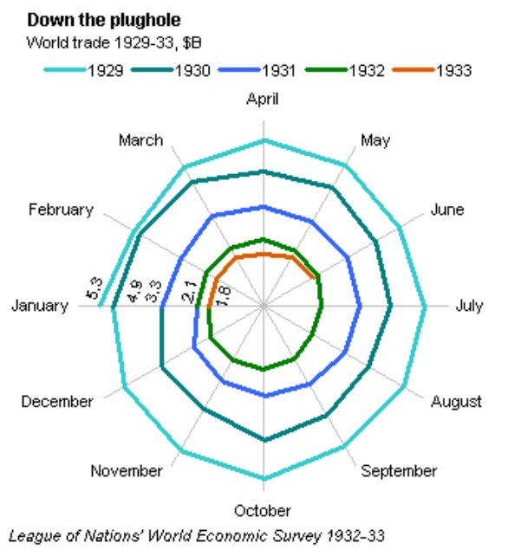
Kindleberger Spiral

Slide 8
Smoot-Hawley Tariffs
1930’s
  World trade shrank dramatically
  1934: Roosevelt signed Reciprocal Trade Agreements Act
    Reduced tariffs
    Allowed president to negotiate bilateral tariff reductions
    Subject to MFN (Most Favored Nation) requirement
  Tariffs of US and others fell

Slide 9
Smoot-Hawley Tariffs
Did Smoot-Hawley tariffs cause the Great Depression?
  No. It was already starting
Did Great Depression cause Smoot-Hawley?
  No. Protectionist forces were strong before
Did Smoot-Hawley make Depression Worse?
  Yes

Slide 10
US-Japan trade frictions
Starting around 1980, the US had
  Tight money to fight inflation
  Recession
  Appreciating US dollar, by about 50%
Japan’s exports to the US rose
  Especially autos
  Also steel

Slide 11
Source: Federal Reserve, “Broad Index” based on a large group of currencies, monthly data
Notes:
http://www.federalreserve.gov/releases/h10/Summary/indexbc_m.txt
Dollar Index Broad Real 2007.xls

Slide 12
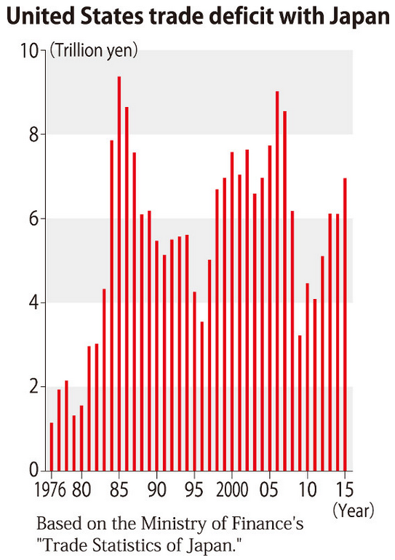
Notes:
“Trump policies aimed at reducing trade deficit with Japan could lead to friction,” Mainichi, January 13, 2017.
https://mainichi.jp/english/articles/20170113/p2a/00m/0na/021000c

Slide 13
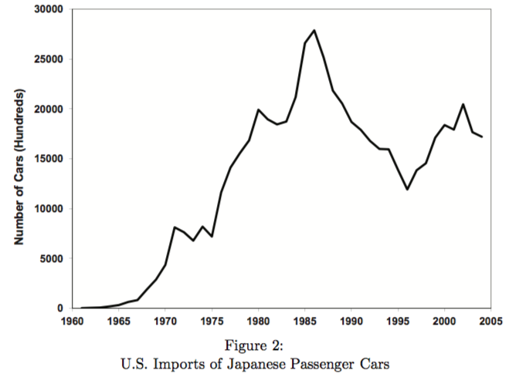
Notes:
Dalton, John T. and Turkmen Goksel, “Reputation and Learning: Japanese Car Exports to the United States,” December 2012.
c940049867795561bd76d4f009fcaaac95a1.pdf

Slide 14
US-Japan trade frictions
Auto sector asked for Safeguard protection
  USITC declined, saying larger cause of injury was recession, not imports
Reagan administration then negotiated Voluntary Export Restrains (VERs)
  Active in negotiations: today’s USTR Robert Lighthizer

Slide 15
US-Japan trade frictions
Effects of VERs
  Like tariffs
    Helps domestic producers
    Raises prices to domestic consumers
    Prompts foreign investment to produce here
  Unlike tariffs
    Government gets no tariff revenue
    Foreign firms get rents (from higher prices)
    Quality upgrading

Slide 16
Trade Disputes under WTO
Under WTO rules
  Countries may not increase tariffs above “bound levels” except under specific circumstances such as
    Safeguard tariffs
    Anti-dumping duties
    Countervailing duties (against subsidies)
  Violations are taken to the Dispute Settlement Mechanism
  VERs are prohibited

Slide 17
Trade Disputes under WTO
WTO Dispute Settlement Mechanism
  Countries complain to WTO
  3-Person Panel evaluates evidence and reports
  Appellate Body reviews decision
  Offending party, if any
    Changes policy, or
    Is retaliated against with tariffs

Slide 18
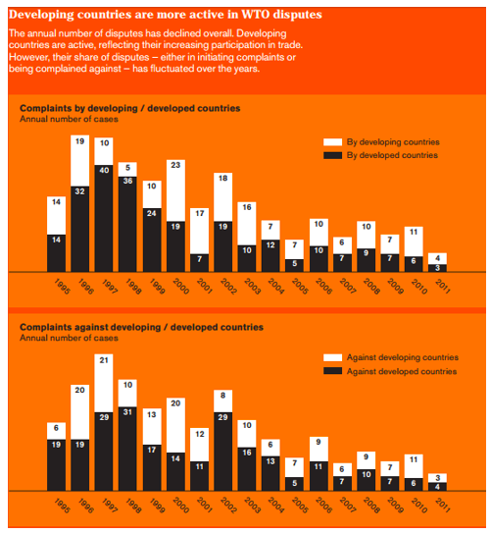
Source: World Economic Forum 2016
Notes:
Hutt, Rosamond, “The World Trade Organization. Here's what it actually does,” World Economic Forum, December 9, 2016.
https://www.weforum.org/agenda/2016/12/world-trade-organization-wto-explained/

Slide 19
Trade Disputes under WTO
The record of findings
  Country bringing complaint wins about 90%
  As complainant (522 cases as of 2017), US had won 91%
  As respondent (129 cases), US had lost 89%.

Slide 20
Trade Disputes under WTO
Major Disputes
  Asia-US shrimp-turtle dispute 1996-2001
  US-EU beef hormone dispute 1996-present
  US steel tariff dispute 2002-2004
  Boeing-Airbus dispute 2004-2017?
  US-China tire safeguards 2009-2012
Some cases drag on or are repeated, but so far disputes have gone through the WTO

Slide 21
Trade Policy under Trump
Actions taken 2017
  Jan 23: Trump pulls out of TPP
  Apr 3: Trump signs 2 executive orders on trade
  Apr 24: 20% tariff on Canada softwood lumber*
  May 18: US launches NAFTA renegotiation
  Oct 5: Negotiation began to amend US-Korea FTA
CVD case begun under Obama

Slide 22
Trade Policy under Trump
Actions taken 2018
  Jan 21: Safeguard tariffs on solar panels and washing machines
  Mar 1: Announces 25% tariff on steel; 10% on aluminum on all countries
  Mar 23: Steel and aluminum tariffs begin, exempting: Canada, Mexico, EU, Australia, S. Korea, Brazil, Argentina (not Japan)

Slide 23
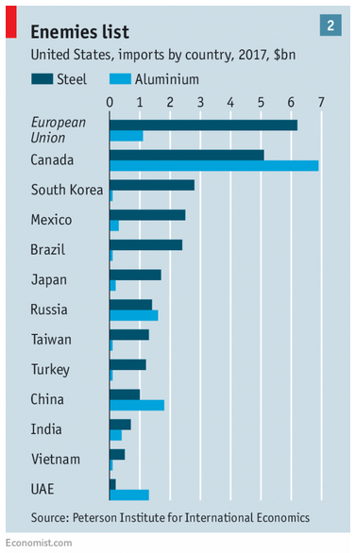
×
×
×
×
×

Slide 24
Trade Policy under Trump
More actions in 2018
  Mar 22: Trump announces tariffs on $50-60 billion of China exports (details announced Apr 2)
  Mar 22: China threatens tariffs on $3 billion of US exports
  Mar 27: Amended KORUS signed (extends tariffs and reduces trade)
  Apr 1: China announces tariffs on 128 US exports
  Apr 6: Trump threatens tariffs on another $100 billion of China exports. China threatens to hit back.

Slide 25
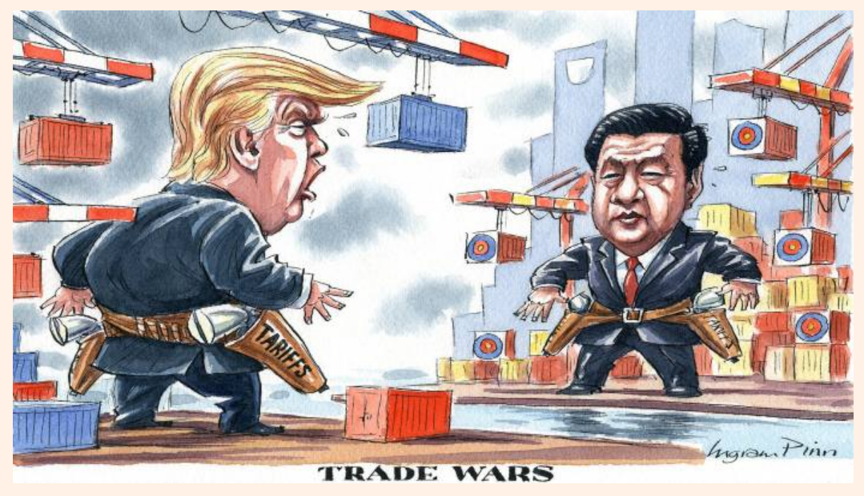
Ingram Pinn, Financial Times, April 6, 2018

